Slide 1

MOAT ACADEMY FOR DEVELOPERS
WEB APPLICATION DEVELOPMENT TRAINING
HTML TABLE AND FORM
HTML DAY 4

Slide 2

HTML TABLE
If you were to create this webpage for University of Birnin Kebbi?

Slide 3
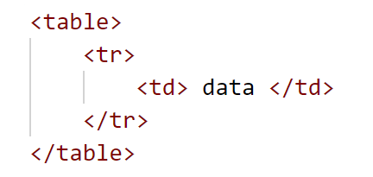
TABLE
Sometimes in your web application, you need to create a table which holds data just as you have it in word processing documents:
A table is a structured set of data made up of rows and columns (tabular data).
A table allows you to quickly and easily look up values that indicate some kind of connection between different types of data.
It is a combination of nested tags

Slide 4
TABLE
An HTML table is defined with the <table> tag.
Each table row is defined with the <tr> tag.
A table header is defined with the <th> tag (instead of <td>). By default, table headings are bold and centered.
A table data/cell is defined with the <td> tag.
The <td> elements are the data containers of the table.
Contents can not be in the <tr> or <table> tag directly!

Slide 5
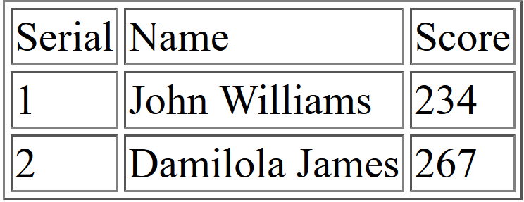
QUIZ
The table tag has border attribute that makes it look like thus:
Create a table with the structure below.
**What do you observe with the width? Any control over this?
Notes:
You can make use of the width attribute, dimensions can be in px or %

Slide 6
ATTRIBUTES OF HTML TABLE
You will notice that the width of the table and each <td> grows with the contents
The table element is somewhat rigid because the size of one <td> affects the other <td>s below and above it.
You can make use of the width attribute to control the size of the width;
Dimensions can be in px or %
Rather than using <td></td> for the heading, we can separate the look and feel of the headings by replacing <td> with <th>

Slide 7
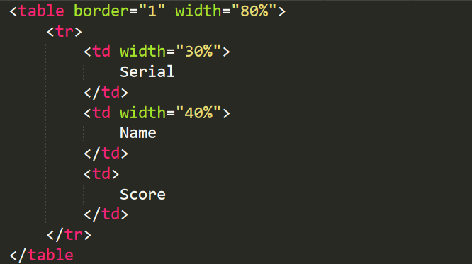
ATTRIBUTES OF HTML TABLE
QUIZ: A table’s dimension has been specified in % as shown below:
What will be the width of the ‘score’ column ?
Notes:
The width grows with contents, the growth of a td affects the tds below it and above making them have the same td hence the rigidity of table
It will be 100- (30 + 40) = 30% NOT 10%

Slide 8
ATTRIBUTES OF HTML TABLE
Other table attributes are: cellspace, cellpadding, align (alignment per td), height, bgcolor
Cellspacing and Cellpadding: attribute of the table (not td)
EXERCISE: Apply any of the above properties on the table you just created
An optional <thead> element, <tbody> and <tfoot> (one benefit of this is we can apply the same styling to all the rows in the body by merely styling the tbody tag.
Notes:
The width grows with contents, the growth of a td affects the tds below it and above making them have the same td hence the rigidity of table

Slide 9
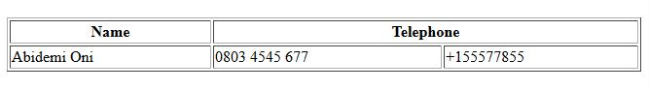
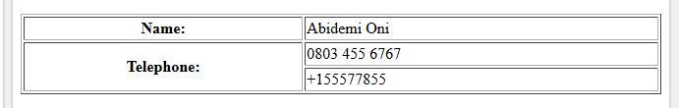
SPANNING TABLE ROWS, (ROWPAN)
SPANNING TABLE COLUMNS (COLSPAN)
Understanding colspan
Understanding rowspan

Slide 10
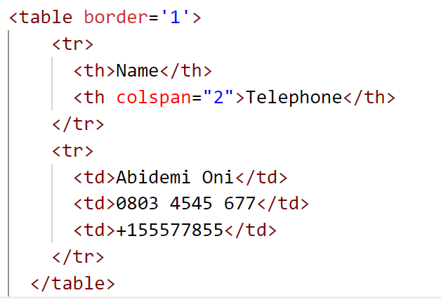
COLSPAN: one <td> occupying many <td> spaces
RAW
<table border='1'>
<tr>
<th>Name</th>
<th colspan="2">Telephone</th>
</tr>
<tr>
<td>Abidemi Oni</td>
<td>0803 4545 677</td>
<td>+155577855</td>
</tr>
</table>

Slide 11
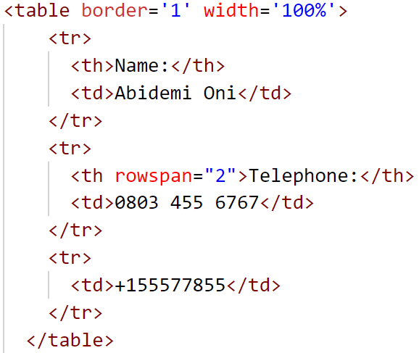
HTML TABLE LAYOUT - ROWSPAN
RAW
<table border='1' width='100%'>
<tr>
<th>Name:</th>
<td>Abidemi Oni</td>
</tr>
<tr>
<th rowspan="2">Telephone:</th>
<td>0803 455 6767</td>
</tr>
<tr>
<td>+155577855</td>
</tr>
</table>

Slide 12
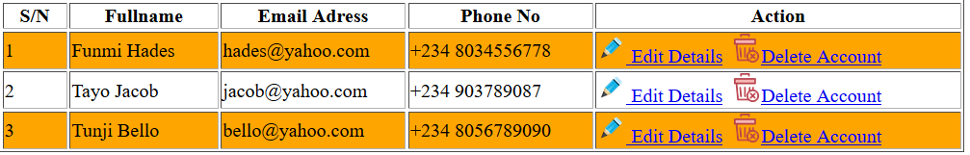
ATTRIBUTES OF HTML TABLE
A table just as it contains the lists of names can contain all sorts of HTML elements; text, images or links.
Tables can also be nested; i.e, a table <td> can even contain another table!
In web applications, a common use of the HTML table is in reporting. For example: we can display the list of all registered users
Exercise: Using HTML table, design something similar to the above.
Notes:
The exercise also tests if participants can resize image to make it fit as an icon
Valign to move contents to the top, middle or bottom of the cell

Slide 13
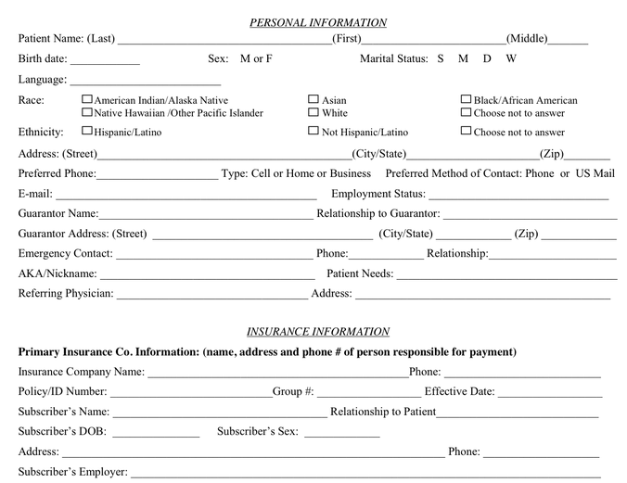
HTML FORM FOR DATA CAPTURE

Slide 14
HTML FORM
The form is used in capturing data from the users
It facilitates dynamic contents on your website
When automating any manual process, converting paper forms to their web equivalence is one of the important tasks you need to do.
Data captured are sent to a page specified.
The submit button is used in sending the data to the specified page

Slide 15
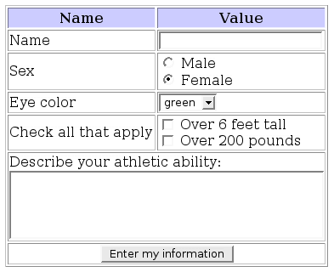
The <form> Element
The <form> Element
The HTML <form> element defines a form that is used to collect user input:
<form>
.
form elements
.
</form>
The form tag has 2 important attributes namely: action and method which specifies the destination page and the means of transporting the data to the destination

Slide 16
FORM ELEMENTS
FORM ELEMENTS AT A GLANCE
input | hidden, text, radio, checkbox, file, date, search, url, email, password, button,submit
textarea | -
label | -
select | multiple select, single select
button | reset, submit, button
An HTML form contains form elements.
Form elements are different types of input elements in different shapes and for capturing varying sets of data,
Examples are text fields, checkboxes, radio buttons, submit buttons, and more.

Slide 17
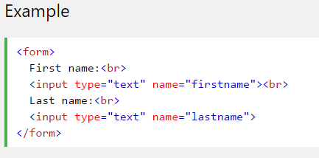
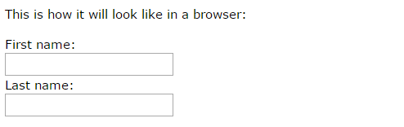
THE input ELEMENT
<input type="text"> defines a one-line input field for text input:
Some attributes of the input text field are: size and maxlength which determines the width and the number of characters it can take respectively
Don’t forget the value attribute!

Slide 18
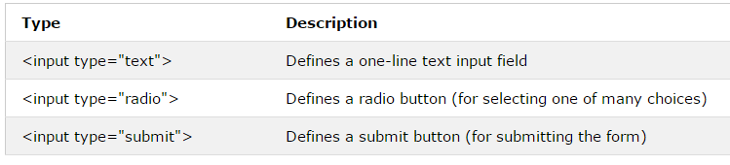
THE input ELEMENT
The <input> Element
The <input> element can be said to be the most important form element.
The <input> element can be displayed in several ways, depending on the type attribute.
Try out these examples:

Slide 19
THE label TAG
Pressing a label basically triggers the focus event for the bound input. Interesting thing is that, if it is a file input, it works out as a click event, resulting in opening a file browser.
<label for="email">Email</label> <input type="text" name="email" id='email’>
Since the id is the same as the content of for=‘’ as shown above , clicking on the label will place the cursor within the email text field
Try it out

Slide 20
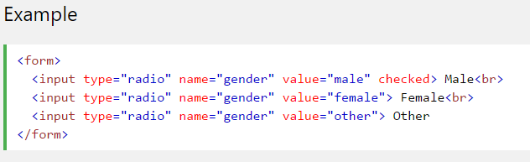
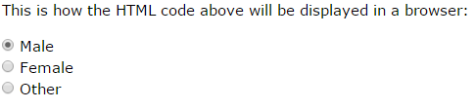
THE RADIO BUTTON
<input type="radio"> defines a radio button.
Using the same name attribute , a set of radio button lets a user select ONE of a limited number of choices:

Slide 21
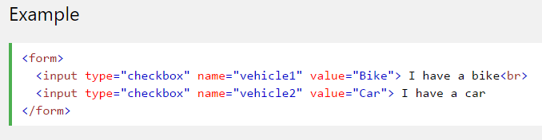
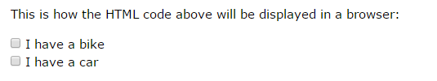
Input Type Checkbox
<input type="checkbox"> defines a checkbox.
Checkboxes let a user select ZERO or MORE options of a limited number of choices.
The value of a checkbox defines what is submitted

Slide 22
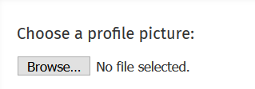
INPUT TYPE FILE
<input> elements with type="file" lets the user choose one or more files from their device storage. Once chosen, the files can be uploaded to a server using some file manipulations (server side or client side)
The tag can optionally have a boolean attribute, 'multiple' to allow the user enter more than one value in the <input> element

Slide 23

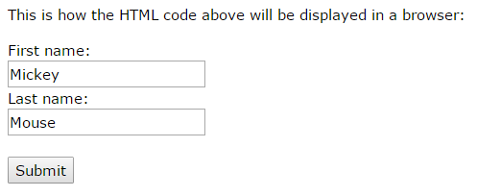
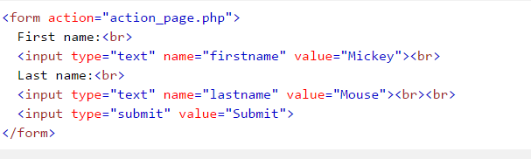
THE BUTTON TAG
<input type="button"> defines a button: Javascripts can be further applied to input of type button to make it perform some interactive functions (this will be covered in subsequent modules)
The Submit Button
<input type="submit"> defines a button for submitting the form data to a form-handler.
The form-handler is typically a server page with a script for processing input data.
The form-handler is specified in the form's action attribute:

Slide 24
TEXT AREA
The <textarea> tag defines a multi-line text input control.
The <textarea> element is often used in a form, to collect user inputs like comments or reviews.
The size of a text area is specified by the cols and rows attributes

Slide 25
HTML FORM – THE BUTTON TAG
HTML 5 Supports the <button> tag, <button> Submit </button>
It has an attribute type which tells the type of button it is: button, submit and reset
If the type attribute is not specified, the default is submit

Slide 26
SELECT DROP DOWN
The basic select drop down is used to collect users input choosing one options out of many options presented with option tag
NOTE: The option tag must be within a select tag
<select name=“country”>
  <option value=“Nigeria”>Nigeria</option>
  <option value=“Ghana”>Ghana</option>
  <option value=“Senegal”>Senegal</option>
  <option value=“Gambia”>Gambia</option>
  </select>

Slide 27
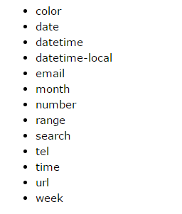
Other HTML5 Input Types
The input of type number defines a numeric input field and can have the following attributes: min, max , step which defines the minimum, maximum number and the number of steps it generates when you make use of the arrow keys
The <input type="range"> defines a control for entering a number whose exact value is not important (like a slider control). Default range is 0 to 100. However, you can set restrictions on what numbers are accepted with the min, max, and step attributes
The type = url, email and the above restrictions automatically helps you validate the input field when submitting the form

Slide 28
SUBMITTING FORM DATA
Action attribute
Method attribute
Form elements name attribute and value attribute

Slide 29
QUIZ
What is the difference between the anchor tag and the submit of a form?
Anchor tag takes us to another page/place without taking data along while the form submit submits data to the specified action page
Notes:
Anchor tag takes us to another page/place without taking data along while the form submit submits data to the specified action page

Slide 30

The <form> Element
The Action Attribute
The action attribute defines the action to be performed when the form is submitted.
Normally, the form data is sent to a web page on the server when the user clicks
on the submit button. In the example above, the form data is sent to a page on the server
called "action_page.php". This page contains a server-side script that
handles the form data:
If the action attribute is omitted, the action is set to the current page.

Slide 31


The <form> Element
The Method Attribute
The method attribute specifies the HTTP method (GET or POST) to be
used when submitting the form data:
or

Slide 32

The <form> Element
When to Use GET?
The default method when submitting form data is GET.
However, when GET is used, the submitted form data will be visible in the page address field:
When to Use POST?
Always use POST if the form data contains sensitive or personal information. The POST
method does not display the submitted form data in the page address field.
POST has no size limitations, and can be used to send large amounts of data.

Slide 33
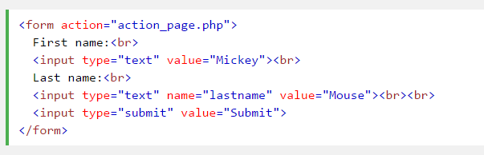
The <form> Element
The Name Attribute
Each input field must have a name attribute to be submitted.
If the name attribute is omitted, the data of that input field will not be sent at all.
This example will only submit the "Last name" input field:
value attribute can be defined explicitly or supplied by the user (where the user can type in values)

Slide 34

ASSIGNMENT
Design a Contact Us Form, your form should capture the following elements:
Email Address, with the use of input type email
Names, with the use of input type text
Gender, with the use of input type radio
Home Address, with the use of textarea
Country, with the use of Select - Drop Down
Checkbox to indicate you want to get a feedback via phone call, Fax
Submit button
Reset Button

